Slide 1
FINANCIAL ADVISOR
CAPSTONE PROJECT
Presented By:
1. ANDRA GOVARDHAN NAIDU-KALASALINGAM UNIVERSITY-CSE(AI/ML)

Slide 2
OUTLINE
Problem Statement (Should not include solution)
Proposed System/Solution
System Development Approach (Technology Used)
Algorithm & Deployment
Result (Output Image)
Conclusion
Future Scope
References

Slide 3
Problem Statement
Many citizens, especially beginners, rural users, and the elderly, lack digital financial literacy, which makes them vulnerable to common online financial threats such as phishing, scams, and misuse of sensitive data (like OTP or bank details). There is a significant need for reliable guidance about UPI, net banking, loans, budgeting, government schemes, and financial security using trusted information sources. Existing solutions often use complex jargon, do not provide multilingual support, or fail to address cultural sensitivity, leaving gaps in understanding and protection for less experienced users.

Slide 4
Proposed Solution
Conversational Guidance: Uses simple language and a friendly, teacher-like tone to explain digital financial concepts including UPI, net banking, budgeting, loans, government schemes, and personal finance.
Safety-First Approach: Proactively warns users about phishing, scams, misuse of OTPs, and dangers of sharing sensitive information. Encourages users to report fraud through official portals like cybercrime.gov.in and their banks.
Trusted Sources: Relies on verified and official portals only, such as RBI, NPCI, Jan Dhan, NSAP, etc., for all financial information.
Jargon-Free Explanations: Avoids technical jargon unless it is explained simply and clearly.
Multilingual & Cultural Support: Assists users in English and regional languages (e.g., Hindi, Telugu) as needed, remaining respectful and culturally sensitive.
No Personal Data Handling: Never requests or processes sensitive information like Aadhaar numbers, bank details, OTPs, or passwords.
Actionable Financial Guidance: Provides step-by-step instructions for basic financial tasks (e.g., sending money via UPI, creating a monthly budget, understanding loan interest rates) and answers frequently asked questions.
Format & Tone:
Short, direct sentences.
Bullet points and simple steps.
Friendly, non-robotic communication.
“Based on available information...” or referral to trusted websites if information is limited.

Slide 5
System Approach
The system approach to building the FinAdvisor (AI Financial Literacy Assistant) involves organizing the project into key components, workflows, and safeguards to ensure reliable, safe, user-friendly guidance for digital finance.

Slide 6
Algorithm & Deployment
1. Algorithm
The AI Financial Literacy Assistant operates through a combination of core machine learning and natural language processing (NLP) algorithms:
Natural Language Understanding (NLU):
Uses NLP models (e.g., transformers, BERT, GPT) to interpret user queries and identify financial topics or user intent.
Machine Learning Models:
Expense tracking and budget prediction use supervised learning models (such as linear regression, decision trees, or LSTM networks) to analyze financial patterns and forecast spending.
Personalized recommendations and financial advice leverage user behavior analytics and clustering algorithms to tailor guidance to individual needs.
Safety features use text classification to recognize potentially risky inputs (e.g., when users mention sensitive info or scam-related keywords) and trigger alerts or guidance.
Knowledge Base Integration:
A curated corpus of verified answers, updated from official portals (e.g., RBI, NPCI), powers rule-based retrieval for common questions.
Multilingual Support:
NLP models are adapted/trained to process queries in regional languages, ensuring accessibility.

Slide 7
Result
project delivers a safe, user-friendly AI assistant that guides users (especially vulnerable groups) on digital financial literacy, protects them from scams, and supports them in managing personal finance confidently—using trusted, official information in clear, jargon-free language.

Slide 8
Conclusion
The AI Financial Literacy Assistant (“FinAdvisor”) project effectively addresses the pressing need for improved digital financial literacy, especially among beginners, rural communities, and the elderly. By delivering easy-to-understand, safe, and trustworthy guidance on topics such as UPI, net banking, budgeting, loans, and government schemes, the assistant empowers users to make informed financial decisions and confidently use digital financial services.

Slide 9
Future scope
The future for AI-powered financial literacy tools is full of promise, with ongoing trends and technological advancements set to further transform personal finance management and inclusion. Here are the primary directions and scope for the coming years:

Slide 10
References
1. Reserve Bank of India (RBI)
Official Portal: The RBI is India’s central bank and regulatory authority for banking and payments. It provides the most trusted information on banking, monetary policy, financial security, and regulatory updates.
[RBI Official Website]
The RBI site provides updated policy rates, banking guidelines, and financial literacy material.
2. National Payments Corporation of India (NPCI)
Official Portal: NPCI oversees all retail payment systems in India, including UPI, RuPay, BHIM, IMPS, and more. It is the main source for updates, complaints, and product/service information for digital payments.
[NPCI Official Website]
The NPCI site offers public FAQs, helpdesk contact info, product features, and news about payment innovations.

Slide 11
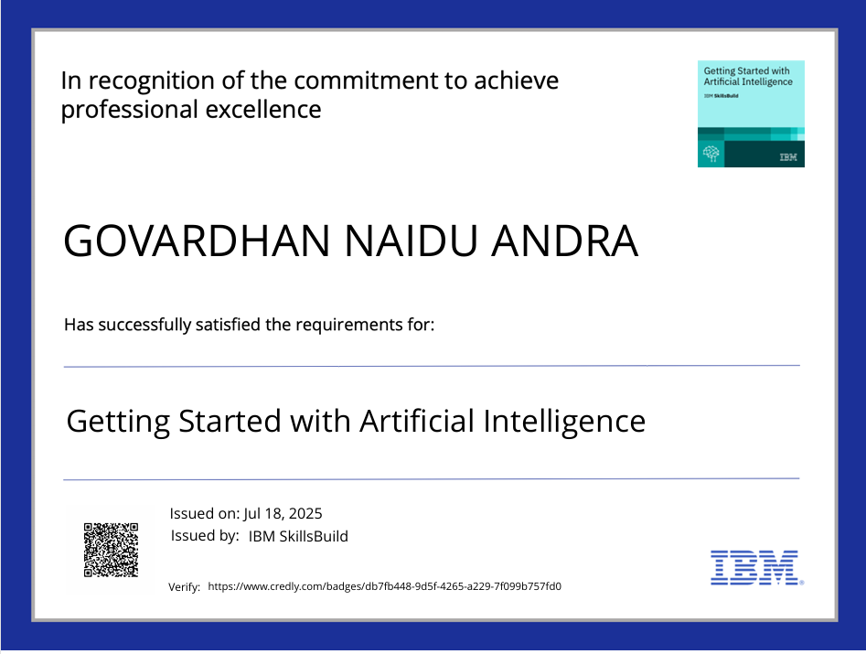
IBM Certifications
Screenshot/ credly certificate( getting started with AI)

Slide 12
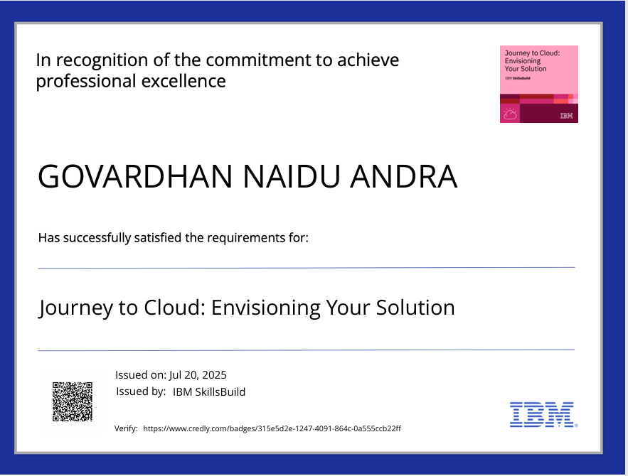
IBM Certifications
Screenshot/ credly certificate( Journey to Cloud)

Slide 13
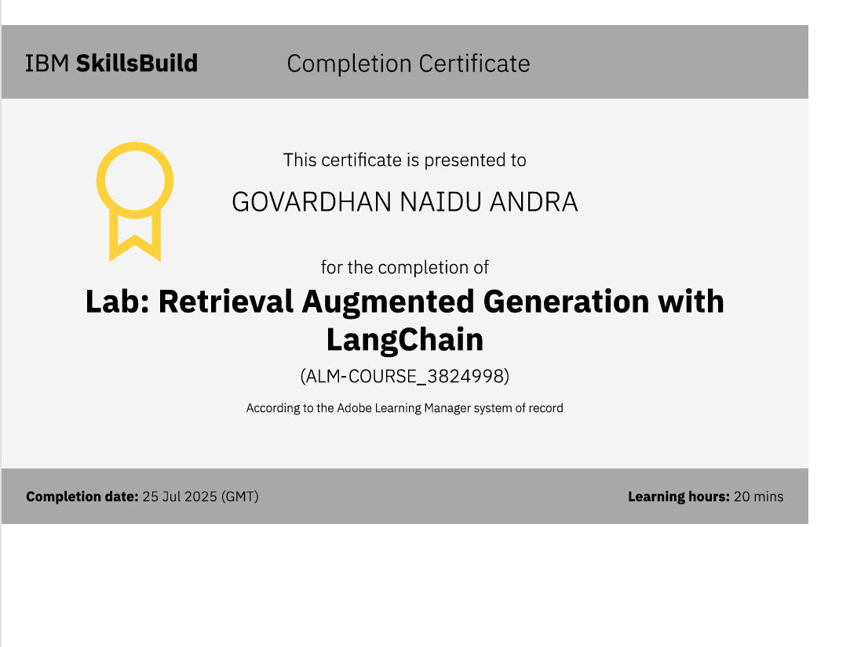
IBM Certifications
Screenshot/ credly certificate( RAG Lab)

Slide 14
THANK YOU

